Slide 1
Java 9 Features with Examples
Presented by: Garima Gupta

Slide 2

Agenda
New Features in java language:
Jshell
JPMS (Java Platform Module System)
Jlink(Java Linker)
Http/2 client
Process API updates
Diff with lower version:
Private method inside Interface
Factory Method to create Unmodifiable collections
Try with Resources Enhancement

Slide 3
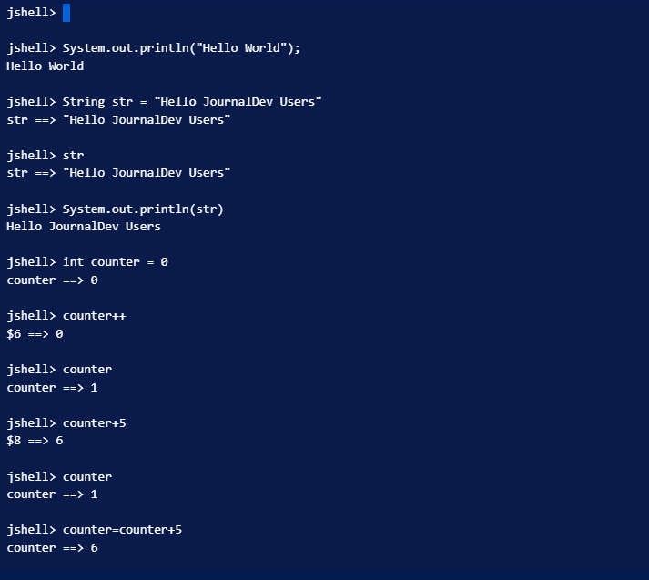
Jshell
Jshell is a REPL(Read-Evaluate-Print-Tool)
Ajshell is an iteractive tool to execute and evaluate java simple programs like variable declarations, statements, expressions, simple programs etc.
command Line tool which allows developer to coding in java without building projects in IDEs.
Compiling and Running their short code.
Jshell is similar with interpreted languages like python and other JVM languages like Groovy or Scala.
Running Shell is just .. Tying jshell in your terminal

Slide 4
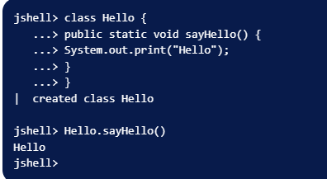
We can also define and execute class methods in Java REPL shell.
To get jshell tool help section , use /help command.
To exit from jshell , use /exit command

Slide 5
Java Platform Module System
JPMS(Java Platform Module System) is the core highlight of new java 9 release.
Modules are (package like) artifacts containing code, with metadata describing the module and also its relation to another module.
it is compulsory to have mmodule-info.java file
java.base, java.sql, java.logging are example of modules
It is also known as Project Jigshaw
Project Jigshaw
Make it easier for developers to construct and maintain libraries and large application;
Improve the security and maintainability of java SE Platform Implementations in general, and the JDK in particular;
Enable improved application performance.
Use command module, requires and exports

Slide 6
WHY?
Reliable configuration – Developers have long suffered with the brittle, error-prone class-path mechanism for configuring program components. The class path cannot express relationships between components, so if a necessary component is missing then that will not be discovered until an attempt is made to use it.
The class path also allows classes in the same package to be loaded from different components, leading to unpredictable behaviour and difficult to diagnose errors. The proposed specification will allow a component to declare that depends upon other components, as other components depend upon it.
Strong encapsulation and security– The access-control mechanism of the java programming language and the java virtual machine provides no way for a component to prevent other components from accessing its internal packages. The proposed specification will allow a component to declare which of its package are accessible by other components, and which are not.
Scalable java platform- with small memory we can run multiple java applications. Application becomes light weight.
Performance and memory improvement- by using required packages and modules, application performance is increased, and less memory utilized
we can enter the following command:
java --list-modules : In order to see which Modules are available within java.
java --describe-module java.sql: the description of the module defined in given file.

Slide 7
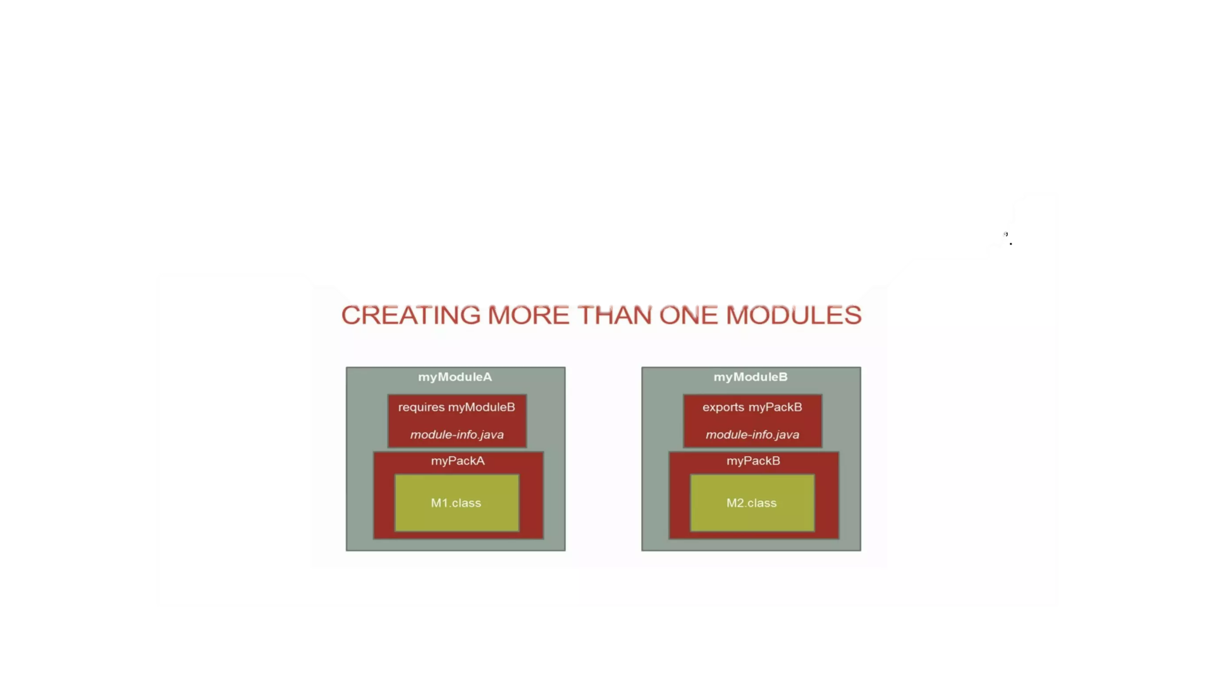
The JPMS consists of providing support for writing modular System for other applications as well as modularizing the JDK source code as well.
JDK 9 is coming with around 92 modules. Java 9 module system has a “java.base” module . It is known as Base module. It is an Independent module and does NOT dependent on any other modules. By default, all other modules are dependent on “java.base”. So you can say it is a container of package.

Slide 8
Jlink
Jlink is java’s new command line tool through which we can create our own customized JRE.
Usually, we run our program using the default JRE, but in case if you want to create your own JRE, then you can go with the jlink concept.
To execute this small “hello World” application, we require following .class file.
- Test.class
- String.class
- System.class
-Object.class
Here, these 4 .class will be enough to run my application.
The default JRE provided by Oracle contains 4300+ predefined java *.class files.
If I execute my “hello world” application with the default JRE, then all the predefined *.class will be executed. But if I only need 3-4 *.class files to execute my “hello world application.”

Slide 9
So using the default JRE means:
Waste of memory and a performance hit.
Will not be able to develop microservices that contain very little memory.
You can find the java.base module in the path:
Java\jdk-9\jmods
So just copy the java.base module and paste it into the folder that has the Test.class file. Now we can create our own JRE by using the command.
Jlink –-module-path out –add-modules demoModule, java.base –output myjre cd myjre
Cd bin
Java –m demoModule/knoldus. Test

Slide 10
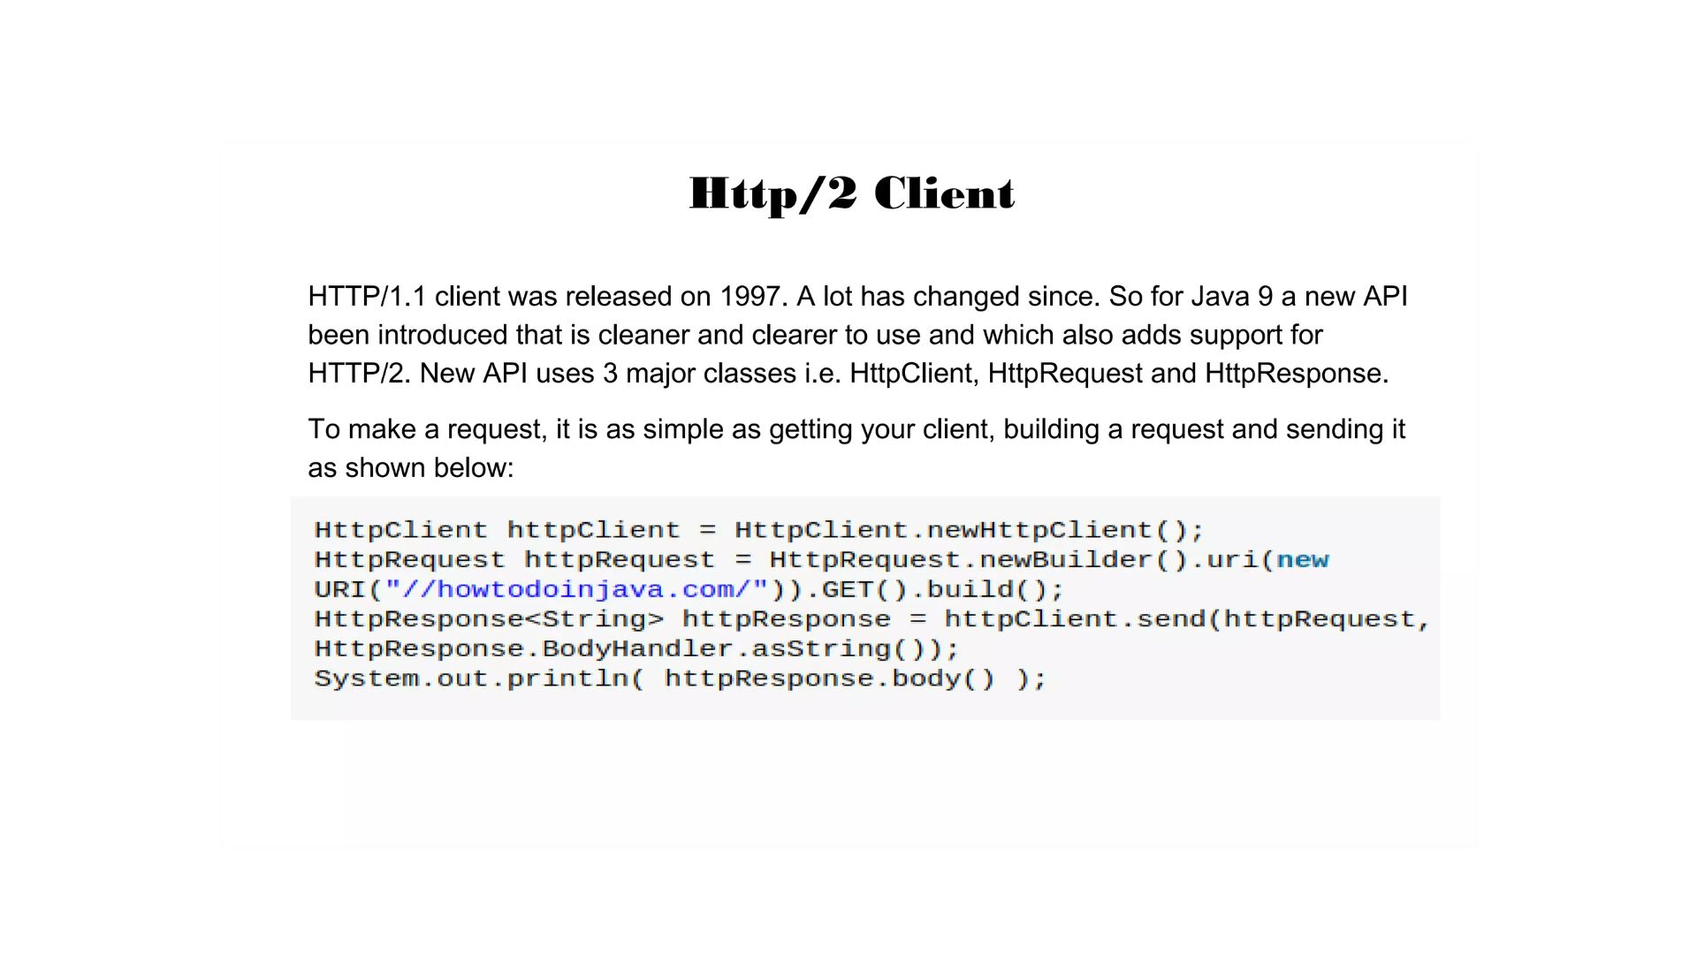

Slide 11
Advantage of HTTP/2
1. In HTTP/1.1, we cannot have more than six connections open at a time, so every request has to wait for others to complete. To avoid this, developers are used to doing workaround as a best practice. Those best practices include minifying, compressing and zipping the files together, sprite images, etc. This can be eliminated by multiplexing in HTTP/2. This means that HTTP/2 can send multiple request for data in parallel over a single TCP connection.
2. Text is replaced by Binary in HTTP/2.0
3. In an HTTP/1.1 environment, an HTML page is sent to the browser. The browser has to parse it and decide which assets are required, the request those assests from the server. This can be eliminated by Server Push in HTTP/2. It allows servers to push responses proactively to the client instead of waiting for the new request to process.
4. In HTTP/1.1, every request sent to the server will have the header’s additional data, which increases bandwidth. This can be eliminated in HTTP/2.0 by having headers packed into one compressed block that will be sent as a unit and, once transmission is finished, the header blocks are decoded. It uses Hpack for header compression.

Slide 12
Process API updates
Java 9 is coming with some improvements in process API. They have added couple new classes and methods to ease the controlling and managing of OS processes. Two new interfaces in process API which makes common operations on native processes much easier.
Java.lang.ProcessHandle
Java.lang.ProcessHandle.Info
Before java 9, there was no standard solution to get the native ID of current process. One could use java.lang.management.ManagementFactory as follows:
In java 9 we can use the pid() method of current ProcessHandle;
Long pid = ProcessHandle.current.pid();
Checking if a process is currently Running
Process process = ProcessHandler.current();
Boolean isAlive = process.toHandle.isAlive();

Slide 13
Private Method inside Interface:
Java 9 onward, you are allowed to include private methods in interfaces
To avoid redundant code and more re-usability
Using private methods, now encapsulation is possible in interfaces as well
Private method inside Interface
Using private methods in interfaces have four rules:
Private interface method cannot abstract.
Private method can be used only inside interface.
Private static method can be used inside other static and non-static interface methods.
Private non-static methods cannot be used inside private static methods.

Slide 14
Factory method with Unmodifiable collections
Creating immutable collections. Util java8 if we wanted to create immutable collections, we used to call unmodifiableXXX() methods on java.util.Collections.
Create Immutable List
Use List.of() static factory methods to create immutable lists.
The List instances created by these methods have the following characteristics.:
These lists are immutable. Elements cannot be added, removed or replaced in these lists. Calling any mutator method (i.e. add, addAll, clear, remove, removeAll, replaceAll) will always cause UnsupportedOperationException to be thrown.
They do not allow null elements. Attempts to add null elements result in NullPointerException
They are serializable if all elements are serializable
The order of elements in the list is the same as the order if the provided arguments, or of the elements in the provided array.
List<String> names = List.of(“Lokesh”, “Amit”, “john”)

Slide 15

Factory Method with Unmodifiable Collections
Create Immutable Set
Set Behave very similar to List with only few differences e.g.
Set do not allow duplicate elements as well. Any duplicate element passed with result in IllegalArgumentException.
The iteration order of set element in unspecified and is subject to change.
All Set factory methods have the same signature as List
Create Immutable Map
Map factory methods are same as List or Set overloaded factory methods. Only difference is that the signature of the methods take alternating keys and values as arguments.
Java 9 also provide a special method for creating Map entry instance.
static <K,V> Map.Entry<K,V> entry(K k, V v)

Slide 16
Try with Resources Enhancement
A resource is an object that must be closed once your program is done using it.
For example, a file resource or JDBC resource for database connection or Socket connection resource. Before java 7 these no auto resource management and we should explicitly close the resource once our work is done with it. Usually, it was done in finally block of try-catch statement this Approach used to cause memory leas=ks and performance hot when we forgot to close the resource.
Java 6 and Earlier
try {
//open resources like File,Database connecition, Sockets etc.
} catch(FileNotFoundException e){
//Exception handling
} finally{
// close resources
}

Slide 17
Java 8
FileWriter fw = new File Writer(“output.txt”);
FileReader fr = new FileReader(“input.txt”);
try (FileWriter fw1 = fw; FileReader fr1 = fr) {
//use resources like File,Database connecition, Sockets etc.
} catch(FileNotFoundException e){
//Exception handling
}
// resources are closed as soon as try-catch block is executed.
Java 9:
FileWriter fw = new File Writer(“output.txt”);
FileReader fr = new FileReader(“input.txt”);
try (fw;fr) {
System.out.println(“Hello”);
}

Slide 18
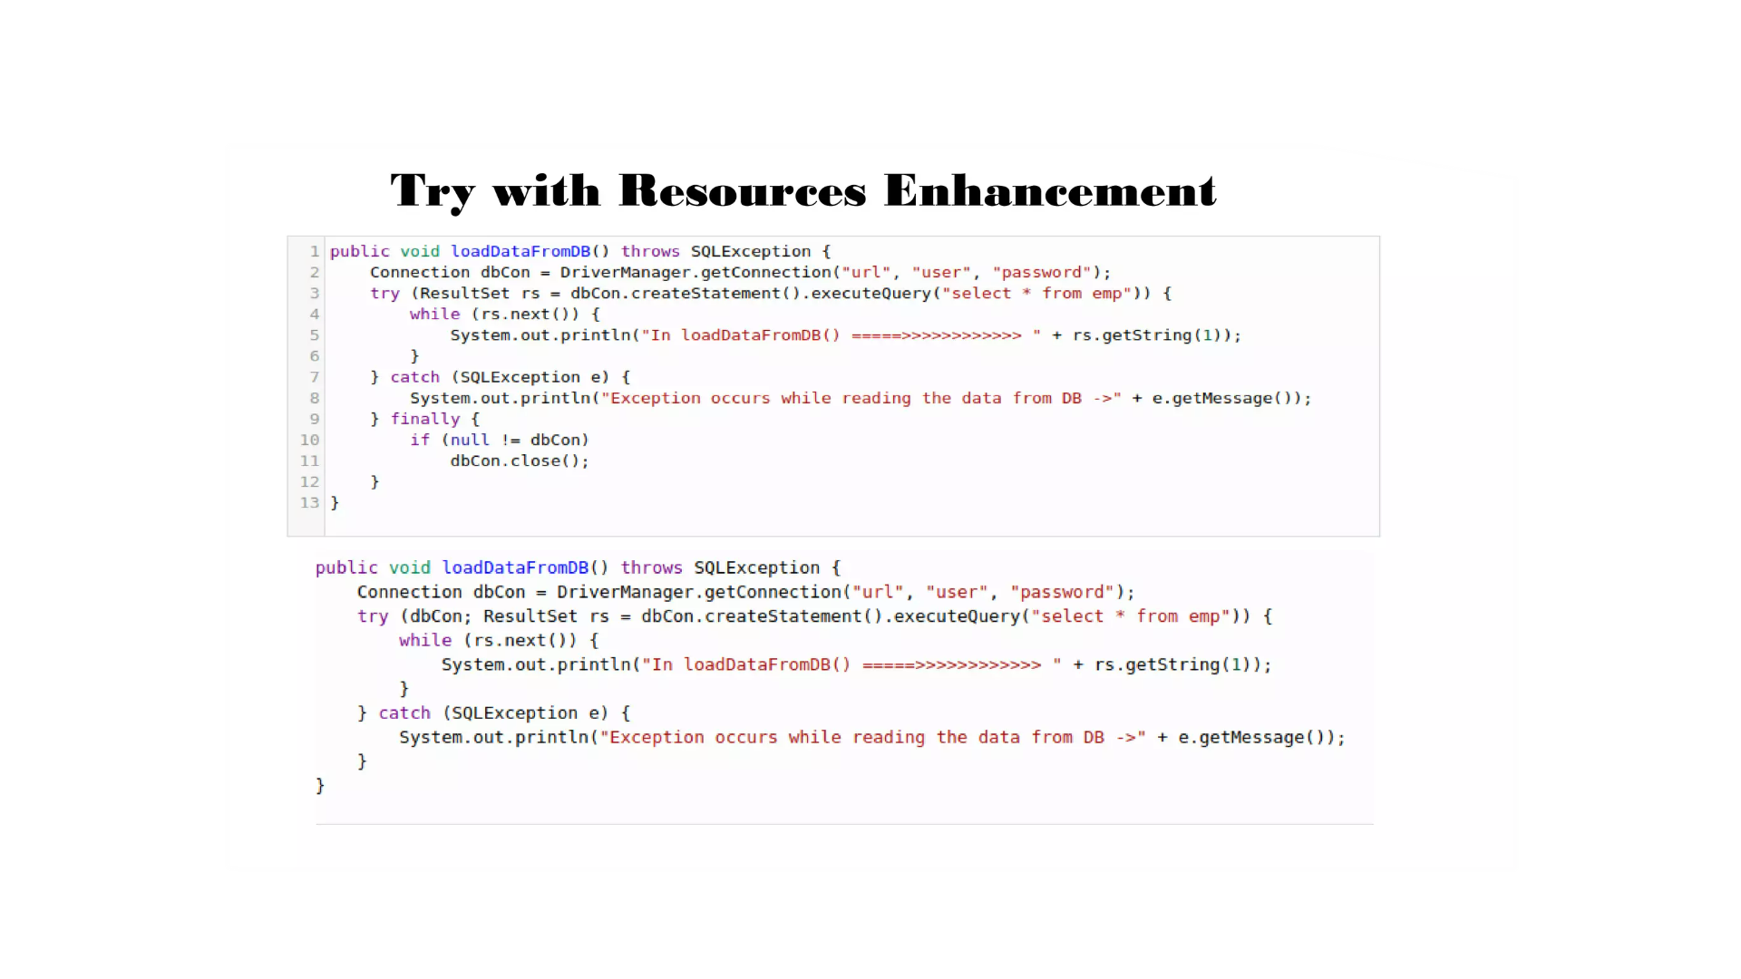

Slide 19
Stream API Improvements: In java 9 , Oracle has added 4 useful methods to Java.util.Stream interface.
dropWhile: this method takes a predicate as an argument and returns a of the subset of given stream avalues after that Predicate return false for the first time.
takeWhile : This takeWhile() takes a predicate as an argument and returns a Stream of the subset of the given Stream values until that Predicate returns false for the first time. If the first value does NOT satisfy that Predicate, it just returns an empty Stream.
Static Iterate(): iterate method is introduced in java 8 with two args. The problem with 2 args method is there may be a change of infinite loop. To avoid this java 9 introduce 3 args iterate method.
public static Stream iterate(T initial value, Predicate condition, UnaryOperator<T> f)
Initial value, a terminate predicate and a function that provide next value.
Static ofNullable(): this method will check whether provided element is null or not. If it is null then will return empty stream. We can avoid NPE.

Slide 20
Diamond Operator Enhancement: To provide type safety and to resolve type casting for collection Generics is introduced in v1.5 . After that Diamond operator is introduced in java 1.7 to avoid type parameter second time while initialization of collection. From 1.9 diamond operator is applicable for anonymous inner classes also.
List<String> ll = new ArrayList<>(){};
SafeVarArgs annotation Enhancement: it is introduced in java7.
Ex. Sum(int… x) : will take any no of variables. Called var-args method.
If we use var-arg method with Generic Type then there may be a change of heap pollution. At runtime if one type of variable trying to point to another type value, then thet may be a chance of ClassCastException.
We can use this annotation for constructors, static and final methods till java 1.8. now this annotation is also applicable for private methods in java1.9.
Very few var-arg methods causes Heap pollution , not all. If we know that our method won’t cause heap pollution, then we can suppress compile warning with this annotation
Ex. @SafeVarargs

Slide 21
References:
https://dzone.com/articles/java-9-modules-introduction-part-1
https://howtodoinjava.com/java9/
https://openjdk.org/projects/jigsaw/
https://www.digitalocean.com/community/tutorials/java-9-features-with-examples#repl

Slide 22


